Slide 1
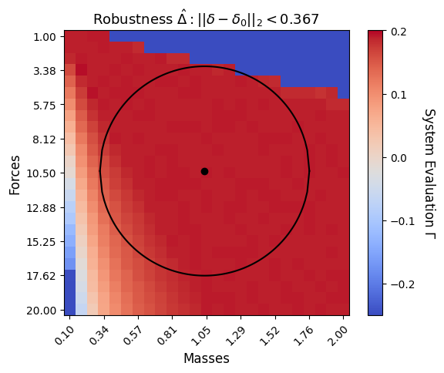
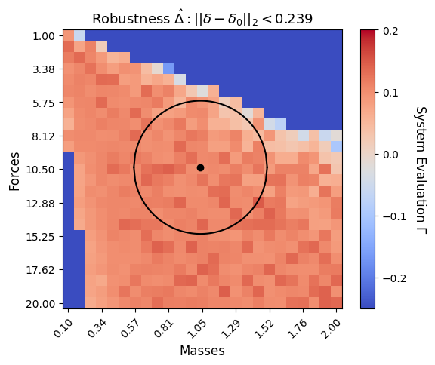
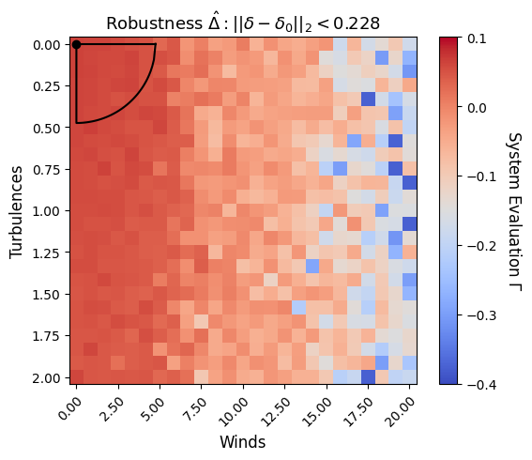
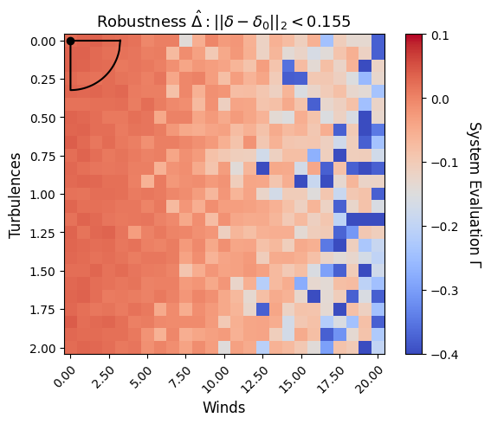
Robustness of Cart-Pole and Lunar-Lander
Cart-Pole with PID
Cart-Pole with DQN
Lunar-Lander with LQR
Lunar-Lander with PPO
Notes:
Every data point in the heatmap indicates a system given some deviation (parameter), and the value of a point is the value of the system evaluation function, i.e., the minimum STL evaluation value (among all traces) of a system. A circle or a sector shows the estimated robustness, and the center of a circle is the zero-deviation point (i.e., no deviation).

Slide 2
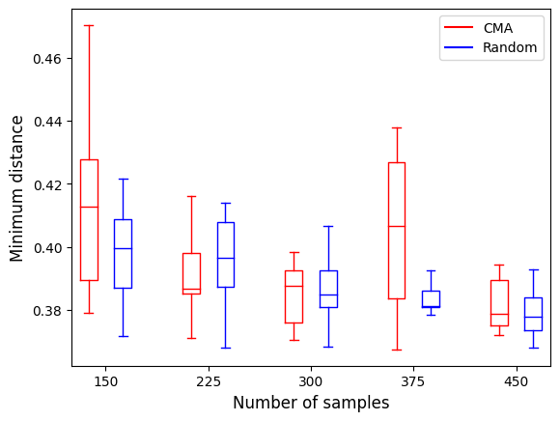
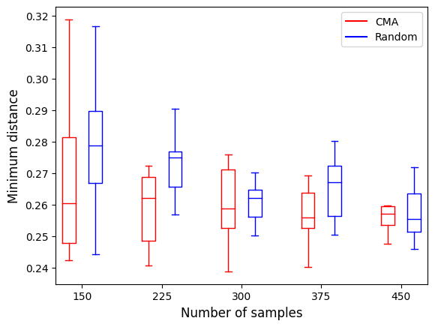
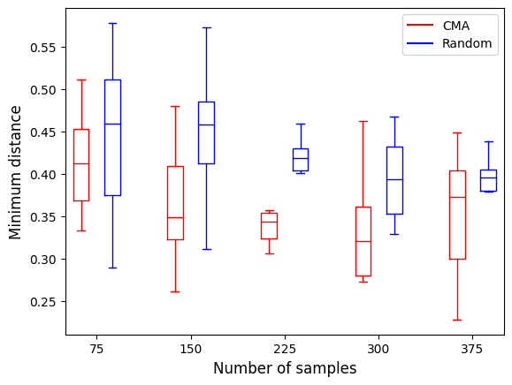
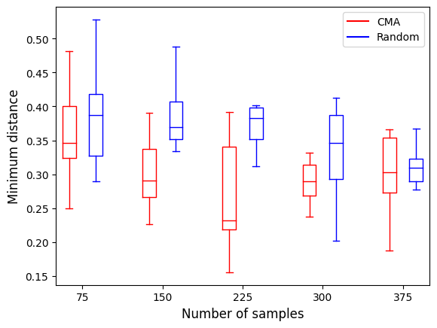
Efficiency of Finding Min Violation
Cart-Pole with PID
Cart-Pole with DQN
Lunar-Lander with LQR
Lunar-Lander with PPO
Notes:
The boxplots show the efficiency of finding minimum violation using CMA and Random Sampling. The y-axis is the distance value of the minimum violation found by each run of CMA or Random Sampling. The x-axis is the number of the total samples. Increasing the sample size can help find a better solution. However, both CMA and Random Sampling do not stably converge into a global optimum.
Random Sampling has similar performance compared to CMA in the Cart-Pole case. This is likely because the global optimum is at the top of the search space and there’s no any form of gradient towards that point.
CMA is marginally better than Random Sampling in the Lunar-Lander case. This is because from left to right of the search space, it shows a gradual degradation of the system evaluation. However, the degradation is not “monotonic” in the sense that a greater deviation does not always produce a smaller system evaluation value. Thus, this also affects the performance of the optimizer.

